Slide 1
Components
נערך על ידי: גילי מנחם

Slide 2
What are they?
Components are one of the core concepts of React. They are the foundation upon which you build user interfaces (UI), which makes them the perfect place to start your React journey!

Slide 3
Why components?
reusable
Return JSX
You can reuse a components anywhere, and provide different props to modify it
Combining HTML, CSS and JS into one markup.
Organization
Components can be imported and exported, allowing you to organize your tree file for more readable code

Slide 4
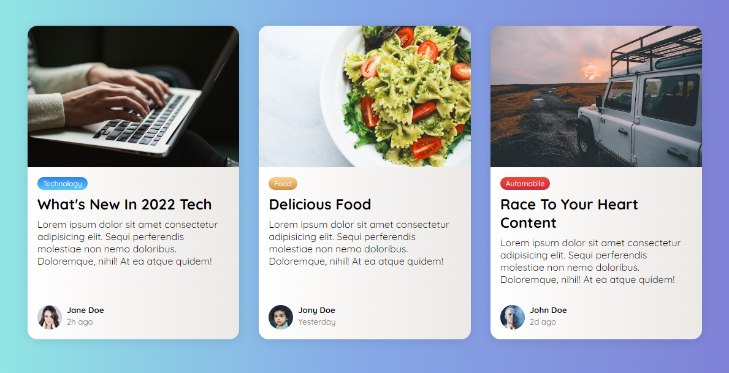
task

Slide 5
states

Slide 6
A Component's Memory
What is it?
Components need to “remember” things: the current input value, the current image, the shopping cart. In React, this kind of component-specific memory is called state.
Why?
Local variables don’t persist between renders. When React renders this component a second time, it renders it from scratch—it doesn’t consider any changes to the local variables.
Changes to local variables won’t trigger renders. React doesn’t realize it needs to render the component again with the new data.

Slide 7


Update Component
To update a component with new data, two things need to happen:
Retain
Trigger
the data between renders.
React to render the component with new data (re-rendering).
The useState Hook provides those two things:
A state variable to retain the data between renders.
A state setter function to update the variable and trigger React to render the component again.

Slide 8

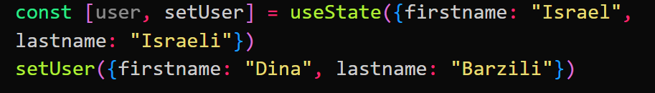
Updating a state
Object
basic
You should treat the state value you have access to in a render as read-only.
To actually trigger a re-render in this case, create a new object and pass it to the state setting function.
Using the setter function to change the value.

Slide 9
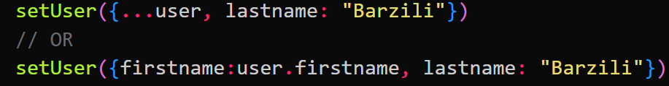
Updating a State - object
Object
You should treat the state value you have access to in a render as read-only.
To actually trigger a re-render in this case, create a new object and pass it to the state setting function.

Slide 10
Task
Begginer – Create a div, on hover, the div changes background color
Medium - Create a red small div that follow the cruser x and y positions
Advanced – create a Counter component. The counter allows to add 2, remove 2. In the same components, count how many times the buttons were clicked.

